Slide 1
Emerging businesses
Predicting the best business location

Slide 2
Predicting location
A small family wants to open their own homemade family-owned dine-in restaurant in a New York City neighborhood, relatively close to the downtown area. As this is their very first attempt at a business venture, they have requested insight on several issues.
With such a diverse population, New York City has a wide range of cuisines and restaurants that can cater to varying price points and a wide variety of people. This creates a difficulty in finding suitable locations for business.
Any business would need to strategize carefully to maximize their reach and exploit the diversity present in New York City’s many neighborhoods.

Slide 3
Business queries
Where would a brand new Mexican/ Latino restaurant find the space to distinguish themselves from the numerous competition and maximize income?
Which neighborhood might have a supportive demographic (presumingly Latino/South American as it would be similar to the restaurant’s culinary influence) to help sustain business?
How much competition might they face regarding similar restaurants? (Regarding proximity to NYC downtown area)

Slide 4
Data acquisition and preparation
The neighborhoods of New York City have a total of 5 boroughs and 306 neighborhoods. In order to segment the neighborhoods and explore them, I created a dataset that contains the 5 boroughs and the neighborhoods that exist in each borough as well as the the latitude and longitude coordinates of each neighborhood. (The link to such datasets: https://geo.nyu.edu/catalog/nyu_2451_34572 - https://cocl.us/new_york_dataset)
New York City’s MOIA Annual Report 2018 was used to examine possible target demographics and extrapolate which backgrounds that might show the most interest.
Foursquare’s services were used to explore and examine New York City’s numerous neighborhoods. Foursquare data was deployed to parse out Venues, User tips, Feedback, Ratings of Neighboring restaurants that would be eventual competition.

Slide 5
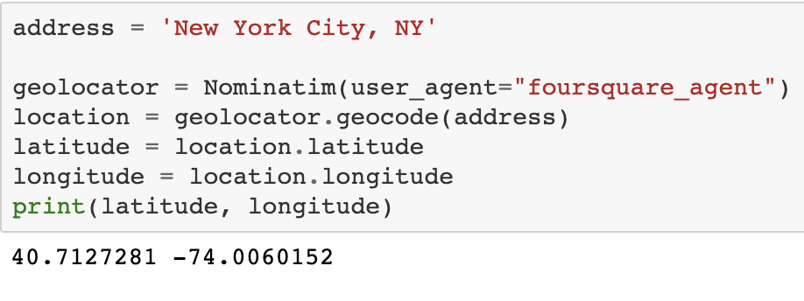
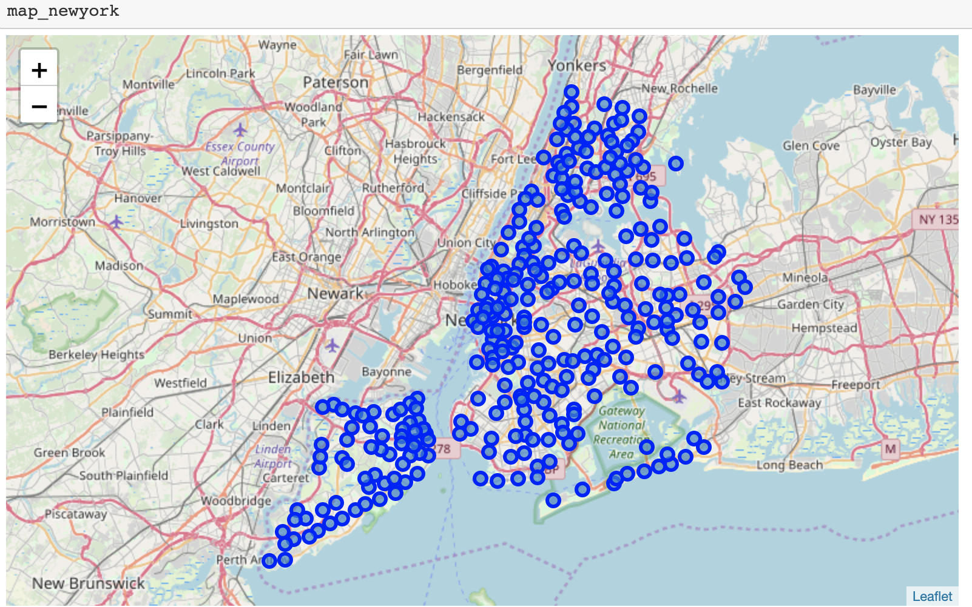
Data selection
Find Coordinates for NYC city center
From these coordinates we can define our prospective neighborhoods using latitude and longitude

Slide 6
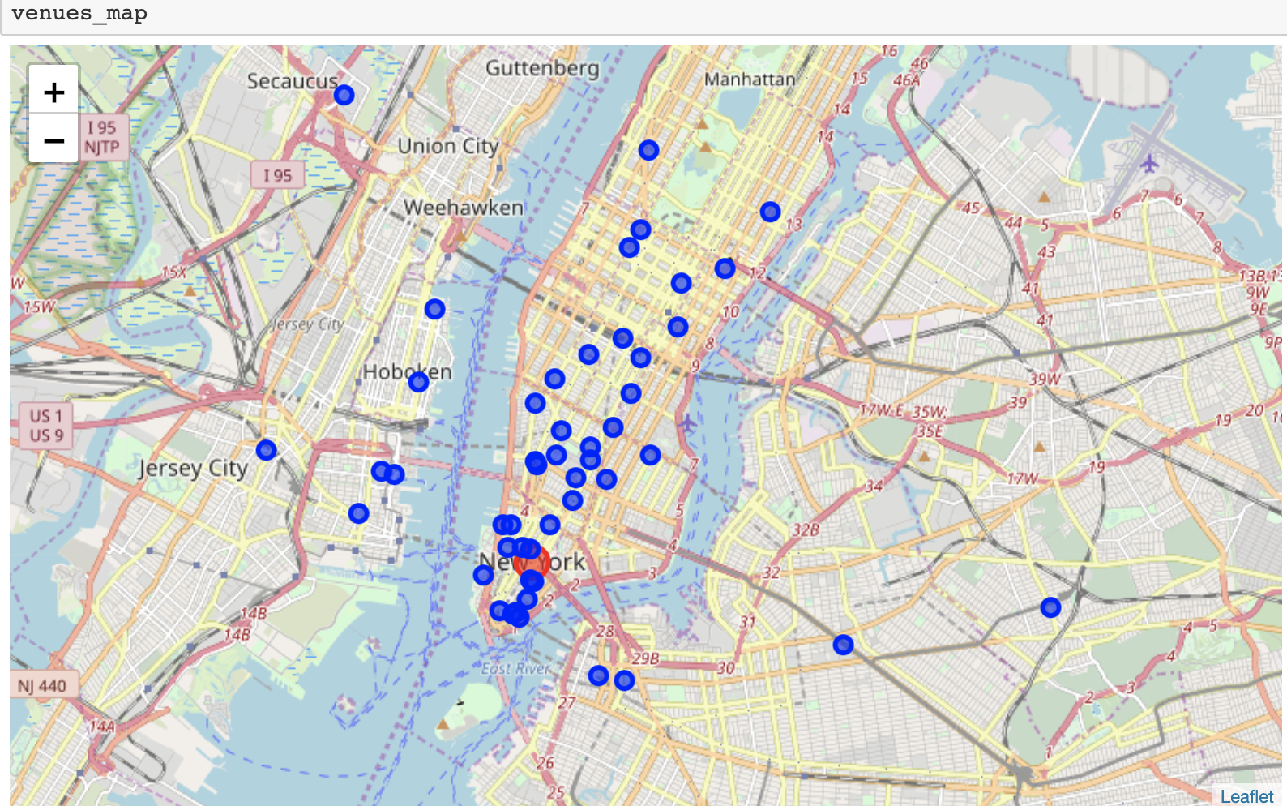
Data selection
While using Foursquare, related Mexican restaurants were gathered in a 16000 meter radius (~10 miles) The red circle denotes the downtown area, while blue circles denotes Mexican restaurants.
The closest proximity was narrowed to 3 Boroughs
Manhattan, Brooklyn, Queens

Slide 7
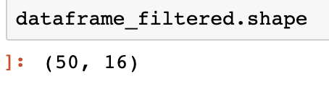
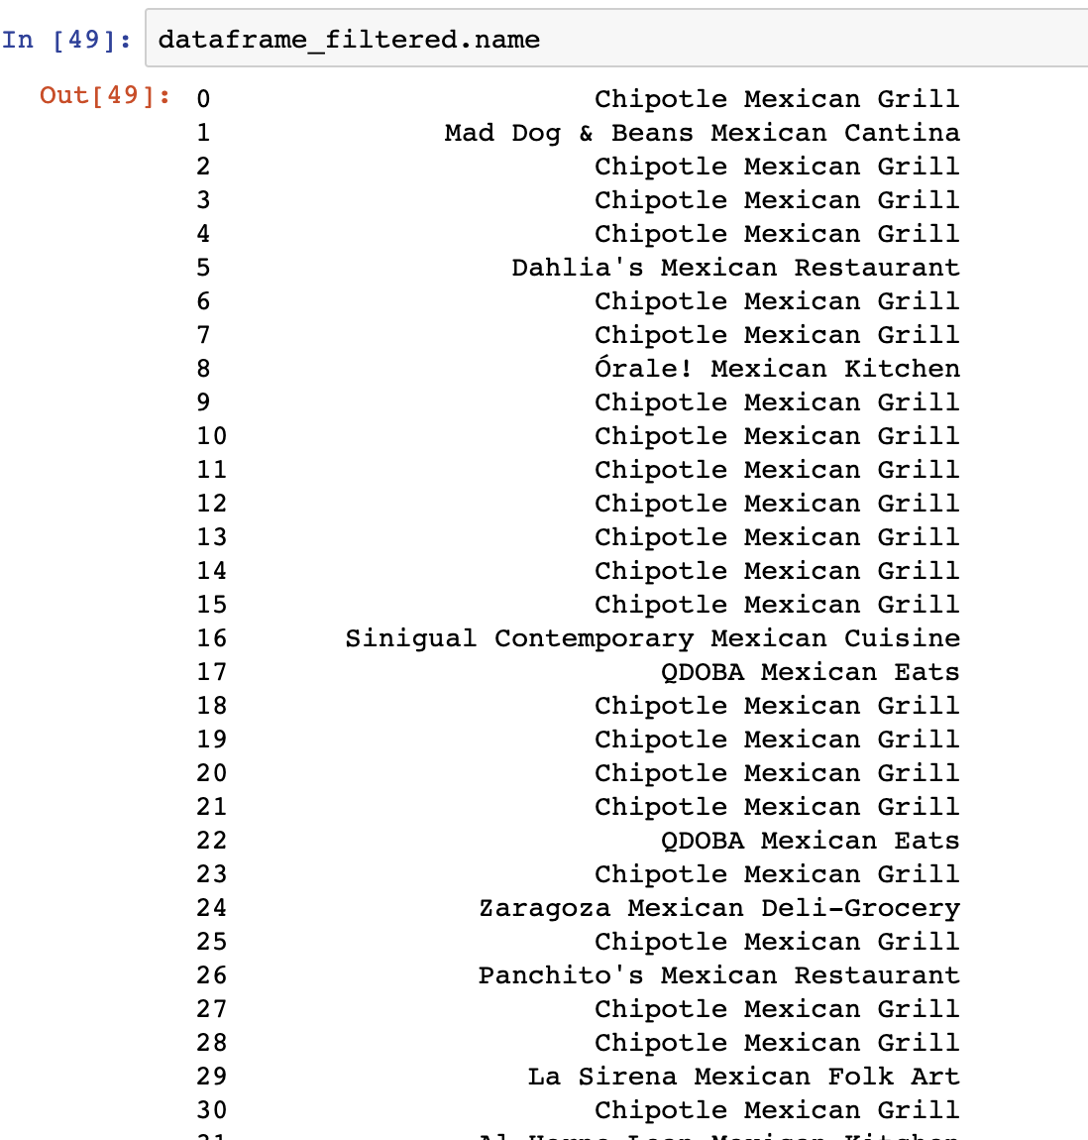
Understanding the data
The restaurants were selected through a limit of the top 60 restaurants in a 16000 meter radius, however only 50 venues were returned through Foursquare API.
From the reported data, we can see that the first snapshot of data is dominated by restaurant chains. Namely, Chipotle Mexican Grill and QDOBA Mexican Eats.
This could prove a special business angle for our clients. Homemade food vs Fast-food.

Slide 8
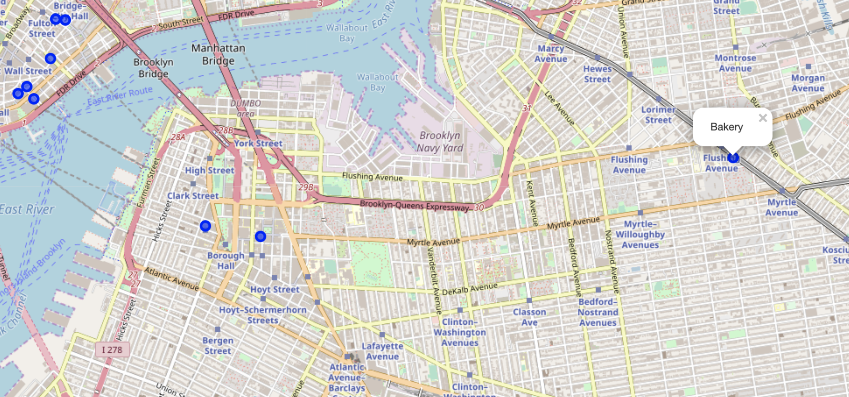
Understanding the data
From the previous maps we can see that Manhattan is completely overrun by Mexican style restaurants
Our clients want to stay close to the city center while being offered an opportunity where their restaurant can emerge among the local competition
From this assertion, Brooklyn satisfies these requirements.

Slide 9
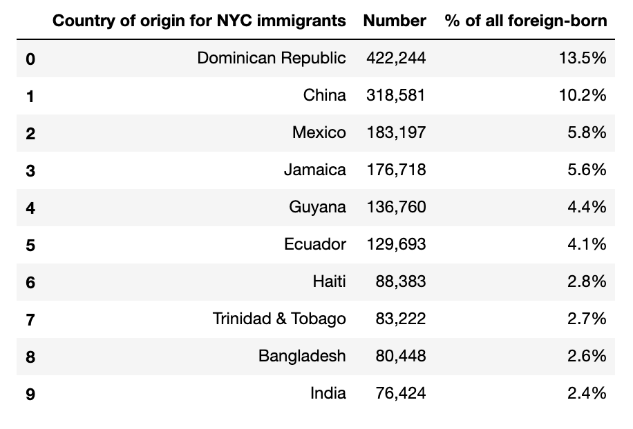
Understanding the Data (MOIA)
The 2018 MOIA Annual Report is the closest approximation to New York City immigration.
The top ten country of origin for NYC immigrants demonstrate several Latin countries which are related to our clients restaurant which could be potential clientele

Slide 10
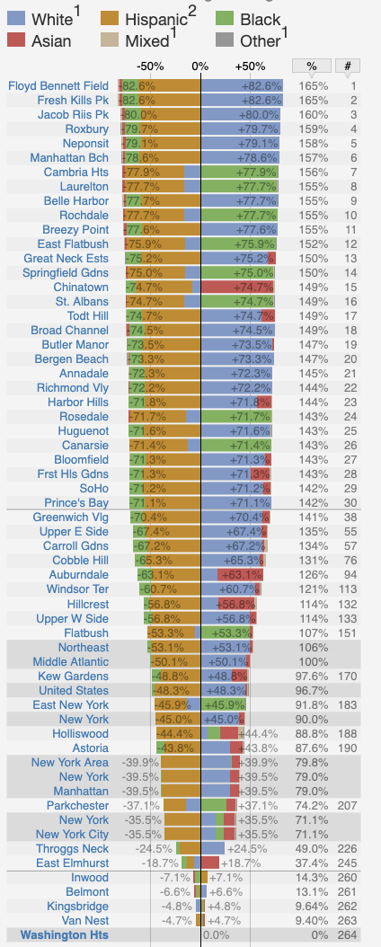
Understanding the data
There was not a reliable or accurate source that could denote the actual location or neighborhood of each demographic.
Instead the only data found were in comparison to other neighborhoods instead of a general over view.
Namely Washington Heights
Relevance will be explained in the Conclusion

Slide 11
Conclusion
For our new clients, West Brooklyn appears to be the best starting location.
It is close to the city center with direct access to the downtown area via two bridges. The only real competition was with Guadalupana Mexican Bakery with a rating of 8.3/10.
However the bakery not a close direct competitor in terms of distance, but also because of their specialty. A bakery and not a restaurant.
The base demographic of Latinos were found in NYC, which may give a supportive clientele, but that would be purely speculation. However it may still comfort the client.

Slide 12
Future recommendations & considerations
Brooklyn is an open area without direct competition
Accuracies of models are subjected to change depending on opening/closures of other restaurants.
Plus the considerations of the surrounding businesses/restaurants were only gathered through Foursquare. There might be unofficial or unverified businesses to consider.
There is high competition in Manhattan, so it would be considered very risky to setup there.
A more detailed analysis might be required to finalize the decision making situation for the clients. Including, but not limited to factors such as rent, human traffic or a comprehensive review of past restaurants in the area.

